Slide 2

Topics
Introduction to Recursion
Problem Solving with Recursion
Examples of Recursive Algorithms

Slide 3
Introduction to Recursion
Recursive function: a function that calls itself
Recursive function must have a way to control the number of times it repeats
  Usually involves an if-else statement which defines when the function should return a value and when it should call itself
Depth of recursion: the number of times a function calls itself

Slide 4
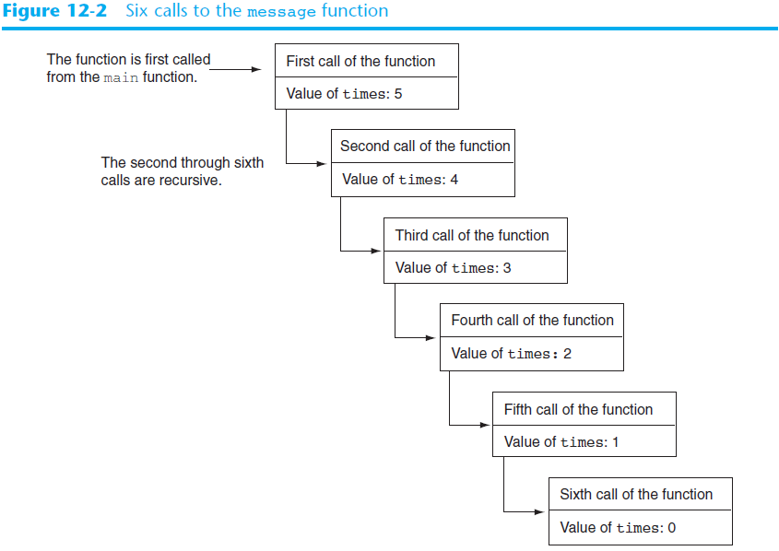

Slide 5
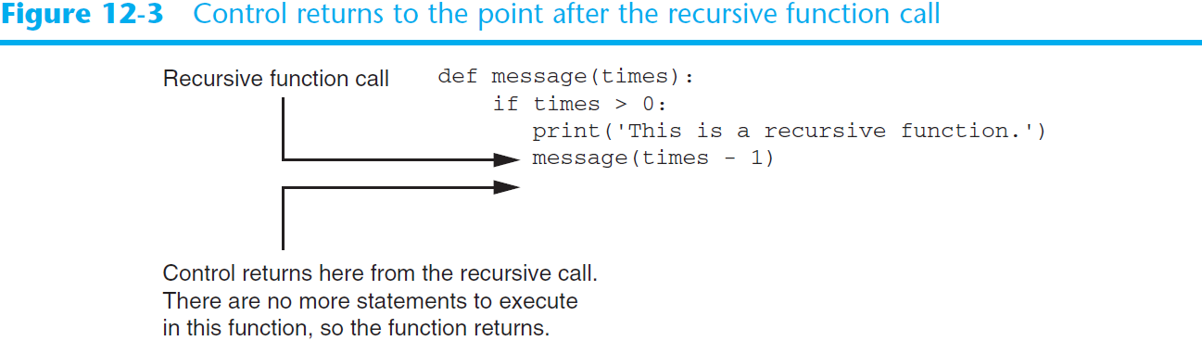
Introduction to Recursion (cont’d.)

Slide 6
Problem Solving with Recursion
Recursion is a powerful tool for solving repetitive problems
Recursion is never required to solve a problem
  Any problem that can be solved recursively can be solved with a loop
  Recursive algorithms usually less efficient than iterative ones
    Due to overhead of each function call

Slide 7
Problem Solving with Recursion (cont’d.)
Some repetitive problems are more easily solved with recursion
General outline of recursive function:
  If the problem can be solved now without recursion, solve and return
    Known as the base case
  Otherwise, reduce problem to smaller problem of the same structure and call the function again to solve the smaller problem
    Known as the recursive case

Slide 8
Using Recursion to Calculate the Factorial of a Number
In mathematics, the n! notation represents the factorial of a number n
  For n = 0, n! = 1
  For n > 0, n! = 1 x 2 x 3 x … x n
The above definition lends itself to recursive programming
  n = 0 is the base case
  n > 0 is the recursive case
    factorial(n) = n x factorial(n-1)

Slide 9
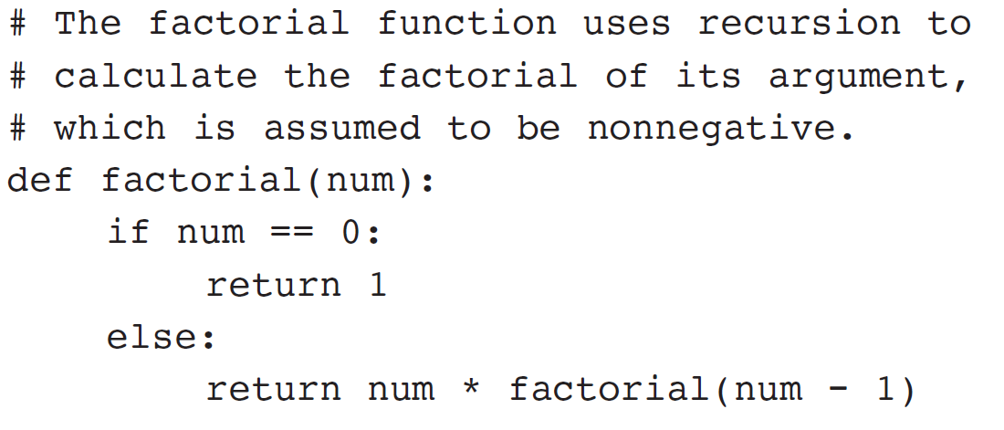
Using Recursion (cont’d.)

Slide 10
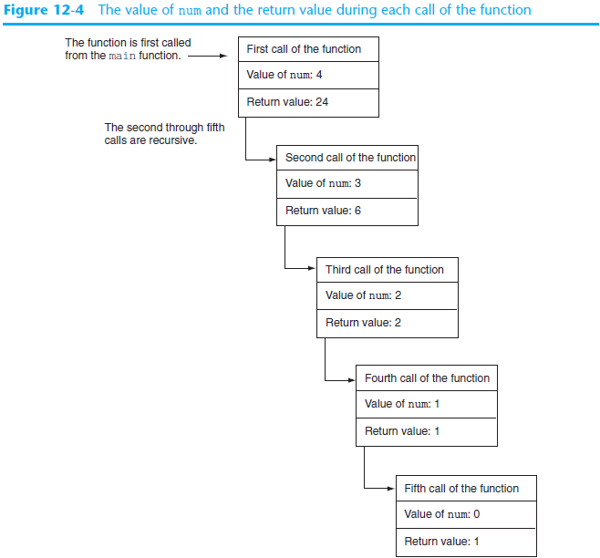

Slide 11
Using Recursion (cont’d.)
Since each call to the recursive function reduces the problem:
  Eventually, it will get to the base case which does not require recursion, and the recursion will stop
Usually the problem is reduced by making one or more parameters smaller at each function call

Slide 12
Direct and Indirect Recursion
Direct recursion: when a function directly calls itself
  All the examples shown so far were of direct recursion
Indirect recursion: when function A calls function B, which in turn calls function A

Slide 13
Examples of Recursive Algorithms
Summing a range of list elements with recursion
  Function receives a list containing range of elements to be summed, index of starting item in the range, and index of ending item in the range
  Base case:
    if start index > end index return 0
  Recursive case:
    return current_number + sum(list, start+1, end)

Slide 14
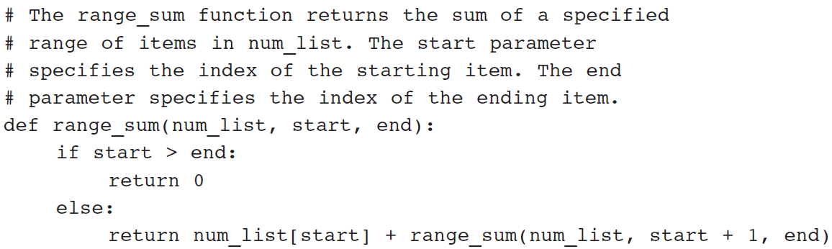
Examples of Recursive Algorithms (cont’d.)

Slide 15
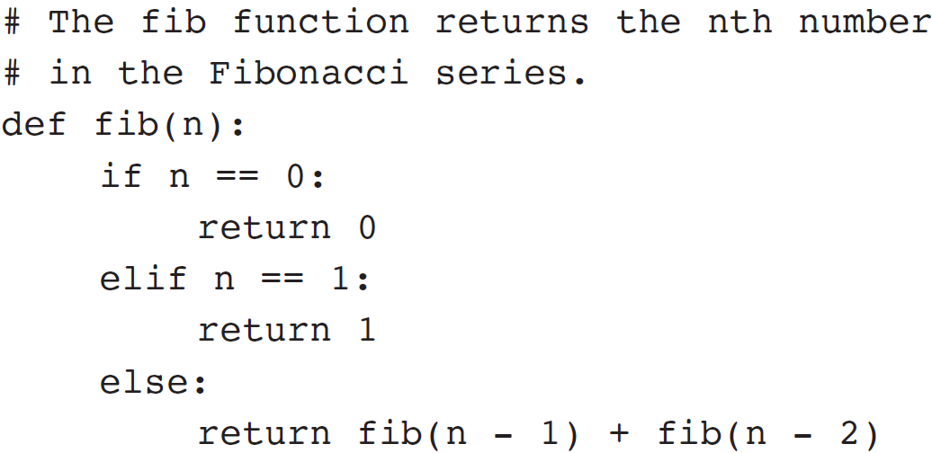
The Fibonacci Series
Fibonacci series: has two base cases
  if n = 0 then Fib(n) = 0
  if n = 1 then Fib(n) = 1
  if n > 1 then Fib(n) = Fib(n-1) + Fib(n-2)
Corresponding function code:

Slide 16
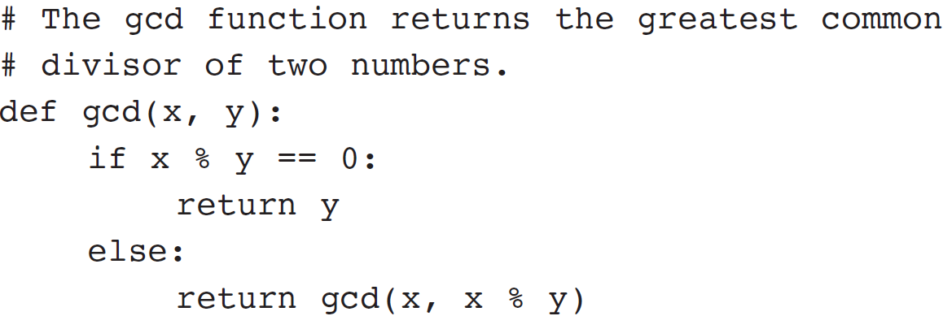
Finding the Greatest Common Divisor
Calculation of the greatest common divisor (GCD) of two positive integers
  If x can be evenly divided by y, then
  gcd(x,y) = y
  Otherwise, gcd(x,y) = gcd(y, remainder of x/y)
Corresponding function code:

Slide 17
The Towers of Hanoi
Mathematical game commonly used to illustrate the power of recursion
  Uses three pegs and a set of discs in decreasing sizes
  Goal of the game: move the discs from leftmost peg to rightmost peg
    Only one disc can be moved at a time
    A disc cannot be placed on top of a smaller disc
    All discs must be on a peg except while being moved

Slide 18
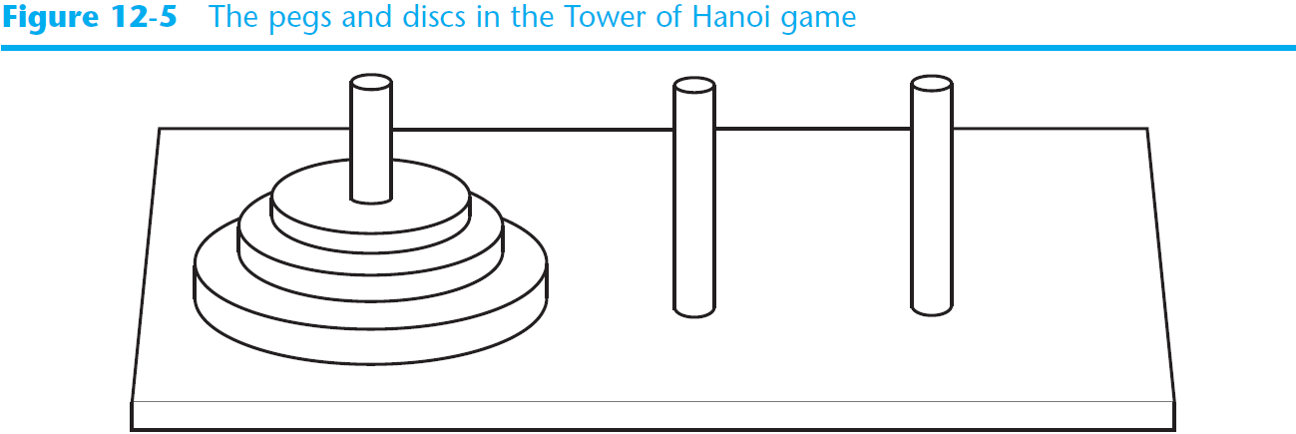
The Towers of Hanoi (cont’d.)

Slide 19
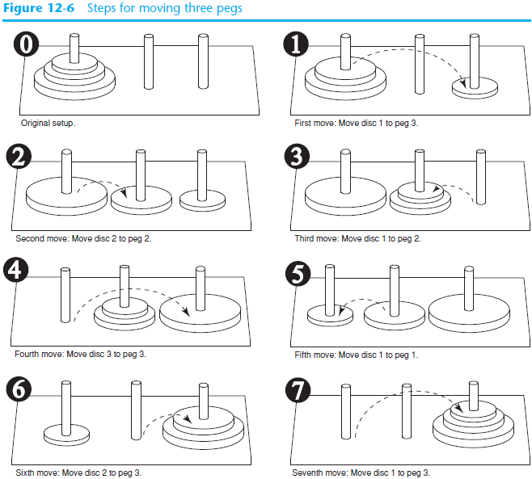

Slide 20
The Towers of Hanoi (cont’d)
Problem statement: move n discs from peg 1 to peg 3 using peg 2 as a temporary peg
Recursive solution:
  If n == 1: Move disc from peg 1 to peg 3
  Otherwise:
    Move n-1 discs from peg 1 to peg 2, using peg 3
    Move remaining disc from peg 1 to peg 3
    Move n-1 discs from peg 2 to peg 3, using peg 1

Slide 21
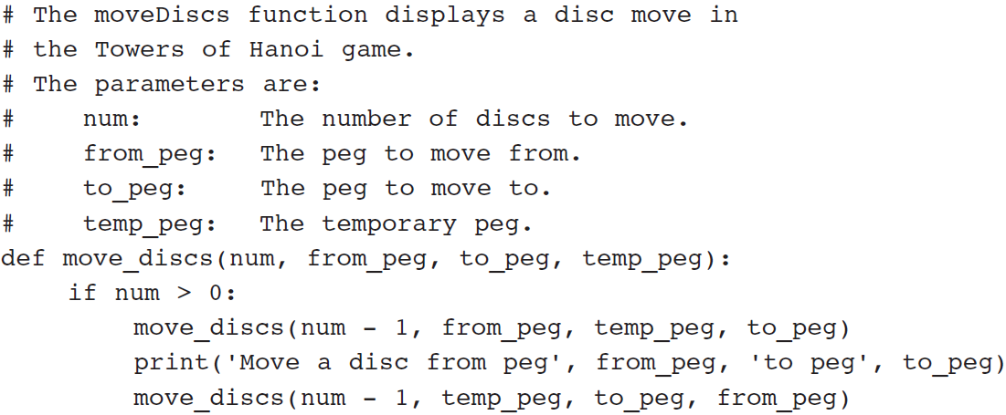
The Towers of Hanoi (cont’d.)

Slide 22
Recursion versus Looping
Reasons not to use recursion:
  Less efficient: entails function calling overhead that is not necessary with a loop
  Usually a solution using a loop is more evident than a recursive solution
Some problems are more easily solved with recursion than with a loop
  Example: Fibonacci, where the mathematical definition lends itself to recursion

Slide 23
Summary
This chapter covered:
  Definition of recursion
  The importance of the base case
  The recursive case as reducing the problem size
  Direct and indirect recursion
  Examples of recursive algorithms
  Recursion versus looping

